Slide 1
Mid Term Presentation
Krishnaraj Thadesar
Associate Software Developer Intern
19th September 2024

Slide 2
Agenda
Introduction
Project Details
Tasks Done
Software and Applications used
Challenges Faced
Takeaways and Learnings

Slide 3
About me and my Team
Me
My Team
Cruise RMS
Part of the Cruise RMS team.
Finished an Angular Training at work.
I intend to also work in making the UI as soon as we finish training.
My team consists of Arun Pratap Singh, Harekishan Shivnani, Sunanda DuttaSen, Rajendra Mulgali and Omkar Chogale
My Mentor and manager is Mr. Harekishan Shivnani.
We are developing a new Product for IDeaS
It involves Forecasting revenue for Cruise Companies.

Slide 4
Cruise RMS
Backend
Database
Frontend
File Processing
Java Spring
Postgres Docker Containers
Relational
Angular
Design process ongoing in Figma

Slide 5



Tasks Completed Till Date – Month 1
Demo Project
Processing Files
Designing Schema
Started with making a demo project to get a hands-on about our tech stack
Process Input files given by client.
Working with my team to design the schema, and learning in depth about it in the process.

Slide 6

Month 2
Process 2 new Files
Analyze Files
Angular Training
Out of Order and Historical Pricing files need to be processed
Perform basic analysis on the file, and try to find any potential errors or edge cases it may have
Attend and learn Angular for building frontend.

Slide 7
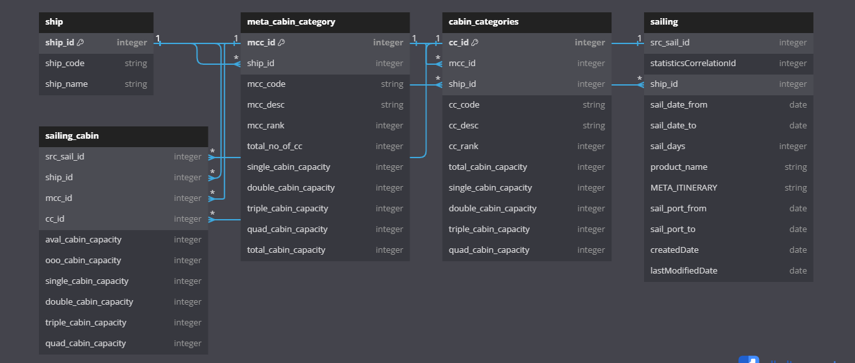
Currently Designed Schema for 2 Files
Work in progress (2 weeks)

Slide 8



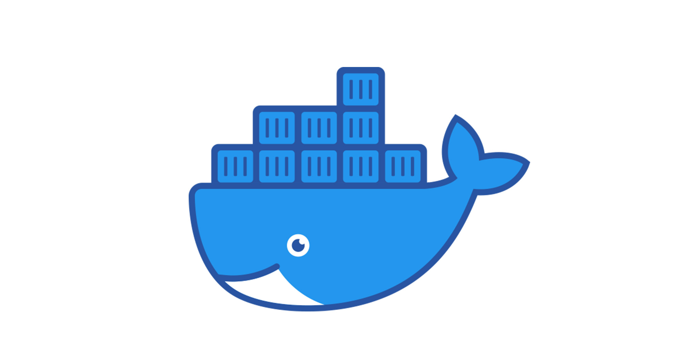


Software and Applications Used

Slide 9

✓
Database Errors and Normalization
✓
Test cases Failing
✓
Non Familiarity with Spring
Challenges Faced

Slide 10
✓
Keeping up with Code Quality
✓
Build failures in github pipeline
Challenges Faced

Slide 11
Technical Learnings
Better code style and technique.
Farsightedness with regards to code, what it will go through, and how to make it robust.
It takes time to design, and its often worth spending that time in the beginning than to regret spending it later, and spend time fixing it instead.
Writing good code that doesn’t work is harder than writing bad code that works, and it is this that makes personal projects easier in comparison to enterprise applications, despite achieving the same result at small scale.

Slide 12
Technical Learnings
All of your code logic for any function must reside within the height of your monitor, and you mustn’t have to scroll. If you do, write functions.
Try to reduce any duplication of code.
Try to induce the feeling of being a developer in your team, rather than a temporary helper.
It is better to do one thing with accountability than 4 things that you aren’t sure about. Reliability > versatility.
Do not love your code.
Do not say something doesn’t work, without completely making sure it doesn’t.
Outline your test cases before you write them, name the functions first.
Merge with main every now and then if your PRs last long.

Slide 13
Personal Learnings
It is often better to focus on learning something well in the beginning rather than to focus on finishing something hastily.
It is in fact true that we don’t even know how much is unknown to us, and available to learn.
It is better to listen and observe, than to intervene and speak, unless prompted to.

Slide 14
Personal Learnings
Being a good listener goes a longer way than we give it credit.
Before you ask request someone anything professionally, make sure they haven’t already done it.
When asked anything, be honest about it. Even if the answer sounds disappointing.

Slide 15
Action Plan
For the remaining 3 Months of the Internship
Process More files – Rest of September
Start working on writing APIs for connecting backend and frontend – October and November
Smooth out file processing on the backend – November
Start writing Angular Code and finish making around 3 to 4 pages in the UI – November & December

